Slide 1
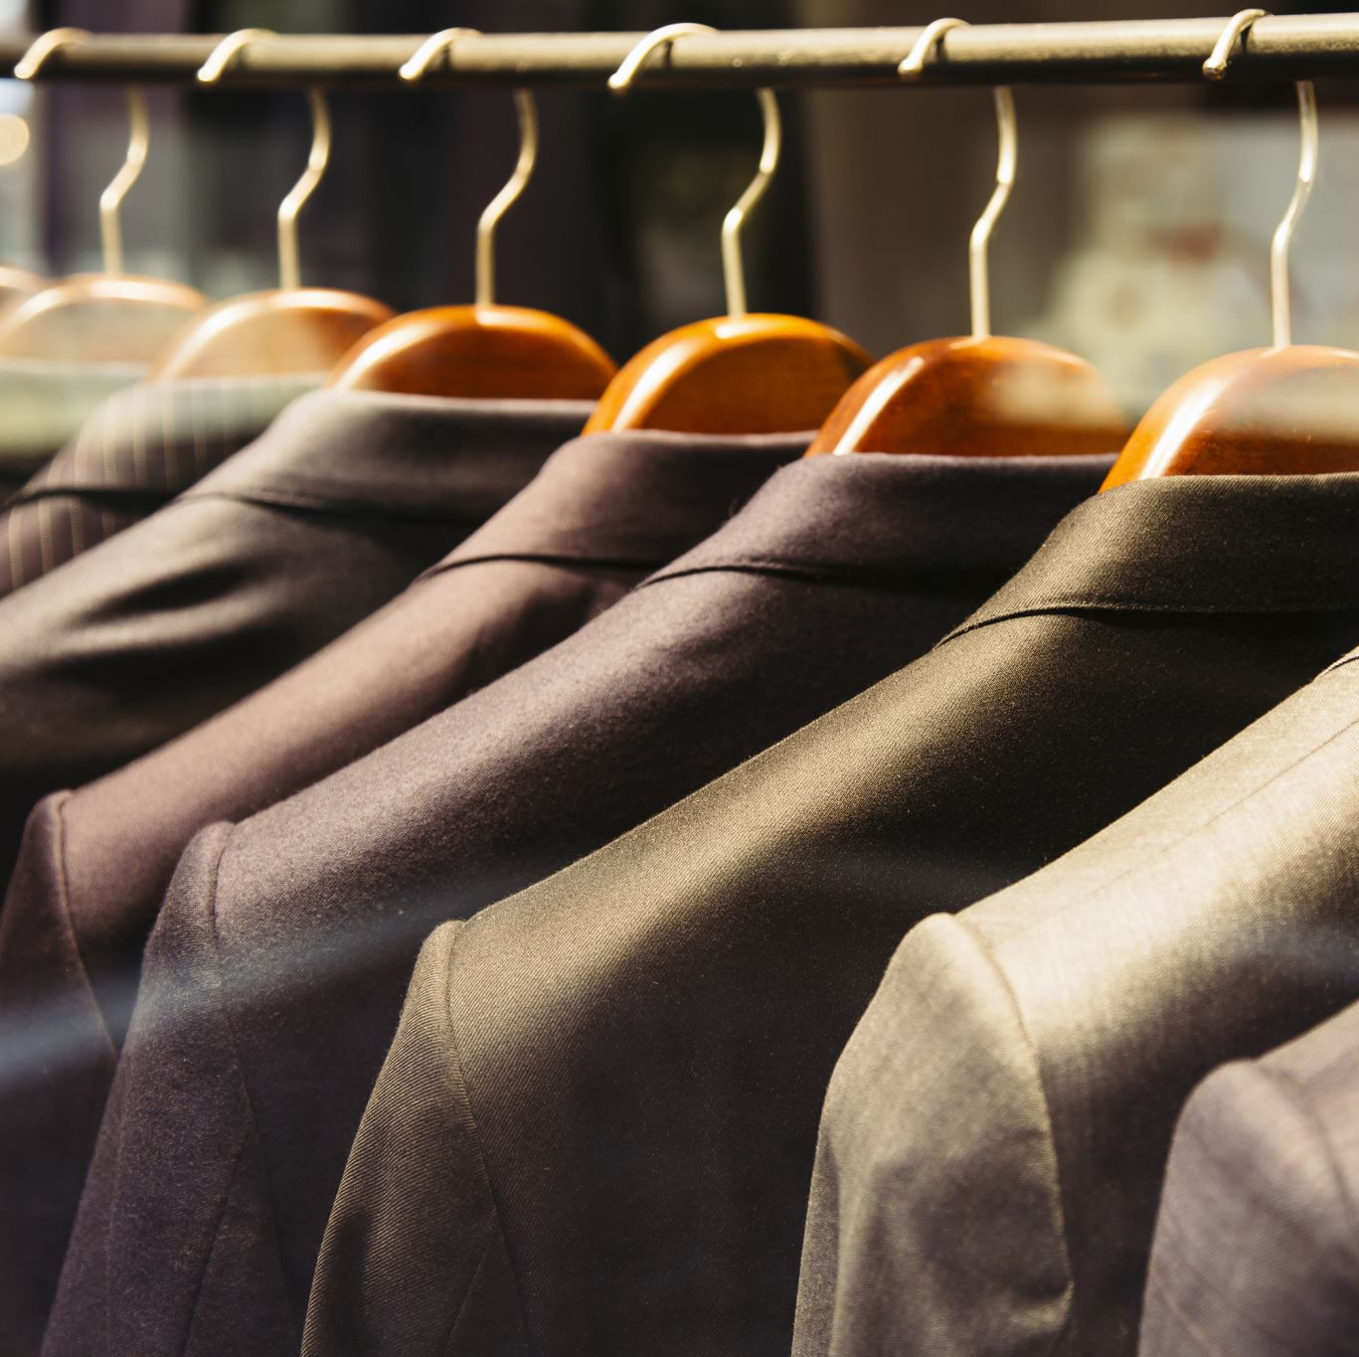
Fashion Recommendation System for eCommerce & AI Stylist
Group 9
Baris Alan - 101474458
Trung Hau Nguyen - 101445701
Yuk Hoi Ng - 101482801
Chun Ting Yiu - 101521540

Slide 2

Background
We are building a fashion recommendation system and AI stylist for eCommerce. Market reports show that personalized recommendations boost sales by 10%, and 91% of consumers prefer brands with tailored suggestions. Using machine learning, we aim to exceed expectations and drive loyalty in eCommerce.
Target:
Enhancing shopping experience
Increased Sales and Revenue
Improved User Experience

Slide 3
Project definition
In-House AI Recommendation System
Utilizing Advanced Machine Learning Algorithms
Employing Generative AI for Interactive User Experience
Seamless Integration for Enhanced User Journey

Slide 4
Objective
KPI | Target | Reason
Total Sales | Increase total sales by 20% compared to the previous year. | Increasing total sales directly impacts revenue generation and business growth
Revenue per User (ARPU) | Increase ARPU by 10% within the next nine months. | Monitoring ARPU allows assessment of the average value generated from each customer, providing insights into the effectiveness of marketing and sales efforts
Return on Investment (ROI) | Achieve an ROI of 5 or higher within the next two years. | Evaluating ROI ensures that the benefits derived from the project justify the associated costs and deliver positive financial outcomes

Slide 5
Business Requirement
Enhancing shopping experience
Competitive advantage
Scalability and Flexibility
Data security and privacy
Integration with Existing Systems

Slide 6
In-House AI Recommendation System
Reason:
Compliance and Control
Alignment with business requirements:
Tailored Recommendations
Differentiation through Personalization
Customized Scalability
Data Security and Privacy
Seamless Integration

Slide 7
SWOT Analysis
Strengths Customization Full ownership Differentiation | Weakness Intensive resource requirement Technical Complexity
Opportunities Revenue growth Data insights Market expansion | Threats Competitive Pressure Data Security Risks

Slide 8
Benefits and Risks
Benefits | Risks
Improved User Experience Expert Fashion Advice: The AI stylist provides expert guidance on fashion trends, styling tips, and outfit suggestions, helping customers make informed fashion choices. | Technical Complexity: High likelihood of encountering challenges due to the technical complexity of developing and maintaining an in-house AI recommendation system. Risk of delays and setbacks in implementation due to the intricacies of advanced machine learning algorithms and integration with existing systems.
Competitive Advantage: Positions our business as an innovator in the market, distinguishing us from competitors. Attracts new customers and retains existing ones by offering unique and personalized shopping experiences. | Data Privacy and Security: Medium likelihood of facing data privacy and security concerns related to handling sensitive user data. Potential risks include data breaches, unauthorized access, and regulatory non-compliance, leading to legal and reputational repercussions.

Slide 9
Implementation Plan
Timeline:
Phase 1
Planning and Requirements Gathering
Phase 2
System Design
Phase 3
Development and Testing
Training and Monitoring
Deployment and Integration
Phase 4
IT Architecture Design
System Development
UI Development
Testing and QA
Data Modeling
Technical Specification
Technology Evaluation
Market Research
Implementation Plan
Stakeholder Interview
Define Project Scope
Issue Resolution
AI System Integration
System Preparation
Maintenance
Documentation
User Training
Phase 5
Deployment with Docker and GCP

Slide 10
Financial analysis - Funding Sources
Internal Funding | External Funding
Allocate Budge - Prioritizing funds based on project importance, strategic alignment, and expected return on investment. 2. Cash Reserves - Access the availability of retained earnings or cash reserves | 1. Financing Options - Loans, lines of credit, or equipment financing from banks or financial institutions 2. Investment Opportunities - Investment from venture capital firms, angel investors, or strategic partners

Slide 11
Financial analysis - Cost Estimate
Development Costs | Operational Costs
Personal (Labour cost) Salaries for AI engineers, software developers, and data scientists. 2. Technology (IT infrastructure components) Servers, storage, networking equipment and software licenses costs. 3. Training and Development Training sessions, workshops and educational material cost. | Maintenance and Support Annual/Ongoing system maintenance, update and technical support. 2. Integration costs Cost of integrating with existing eCommerce platforms, inventory management systems, or customer database.

Slide 12
Financial analysis - KPI estimate
Target | Reason
Increase total sales by 20% compared to the previous year | Increasing total sales directly impacts revenue generation and business growth
Increase Revenue per User(ARPU) by 10% within the next nine months | Monitoring ARPU allows assessment of the average value generated from each customer, providing insights into the effectiveness of marketing and sales efforts
Achieve an ROI of 5 or higher within the next two years | valuating ROI ensures that the benefits derived from the project justify the associated costs and deliver positive financial outcomes

Slide 13
Resource required
Human Resources:
Data Scientists | Skilled professionals proficient in machine learning, data analytics, and AI algorithm development.
Software Engineers | Experienced developers with expertise in programming languages like Python, Java, or C++ for software development and integration.
UI/UX Designers | Designers specializing in user interface and user experience design to create an intuitive and visually appealing recommendation interface.
Project Managers | Project management professionals responsible for overseeing the project, coordinating team activities, and ensuring timely delivery.

Slide 14
Resource required
Data resources:
Training Data | Diverse and high-quality datasets comprising user interactions, product attributes, customer preferences, and historical sales data for training AI models.
Real-Time Data Streams | Access to real-time data streams from the eCommerce platform, including user interactions, product updates, and inventory changes, for dynamic recommendation updates.

Slide 15

Problem Statement
Consumers face overwhelming choices when shopping for fashion items online.
It is often difficult for shoppers to confidently pair clothing and accessories together to create cohesive outfits.

Slide 16
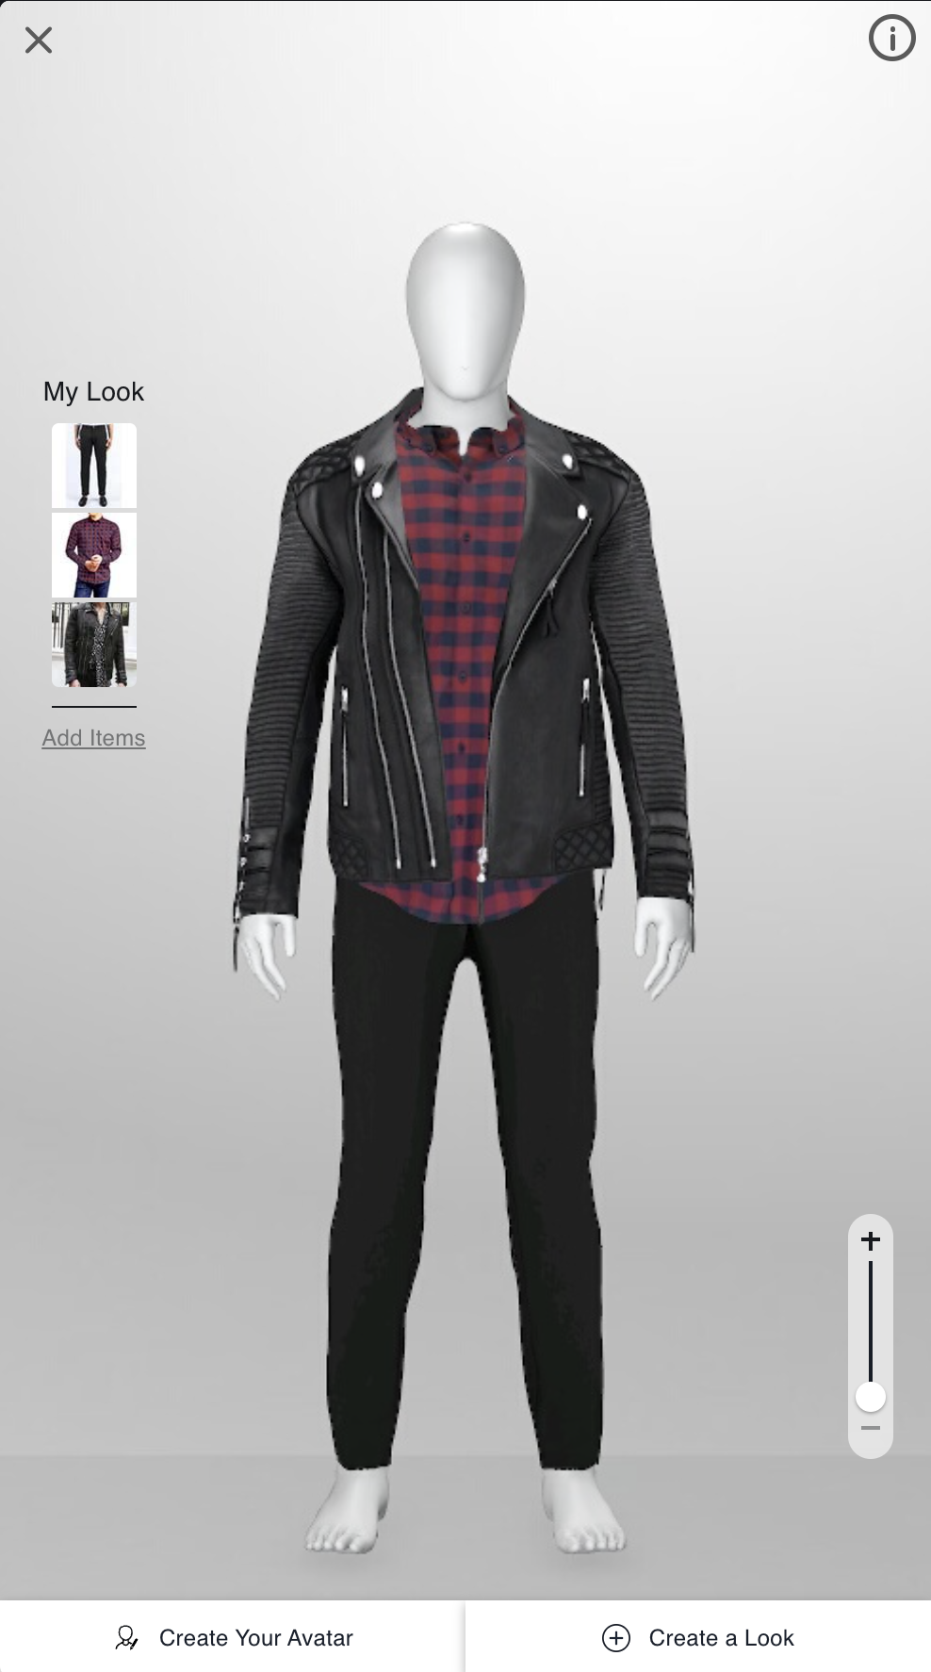
Competitors
Stitch Fix and Trunk Club, who also offer personalized fashion recommendations.
StyleMe employs deep learning to analyze preferences and integrates with 3D models to create their products.
StyleMe user interface

Slide 17
Why this problem?
It impacts the customer's shopping experience and satisfaction.
By addressing this problem, we can significantly enhance their overall satisfaction and increase the likelihood of them making purchases.

Slide 18


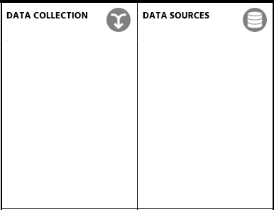

ML Canvas
Who:
- The online shoppers
- Users will benefit from receiving recommendations based on our products and the products they upload while shopping online.
What:
- The key features include image-based product recommendations, managing user carts, adding products to the recommendation, and interact with users by Gen AI
Why:
-Reasons for building a recommendation system include understanding user preferences, improving shopping experiences, and increasing sales.
- Image-based recommendations allow users to easily find visually similar products and enrich the shopping experience.
- Classification, Computer Vision & Generative AI
- Outcome: A list of recommended products with similar feature rankings and an explanation of why these clothing combinations match or do not match, generated by AI.
- Wait time: Instant feedback from clicks and purchases.
Strategy:
- Extracting feature by using deep learning model (ResNet50), then using ML model (KNN) to classify the recommended items to a queried item.
- Using Gemini API to build an AI Stylist.
Data: Fashion Product Images Dataset from Kaggle.
- 44442 high quality images featuring various categories, styles, colors, and genders of clothing.
- styles .CSV file containing detailed features of the products.
- Detailed features of the products are provided in a .CSV file.
- ResNet50 was built to extract high-level features from the product images.
- These image features, along with other product attributes, are used as input features for the machine learning model (KNN).

Slide 19
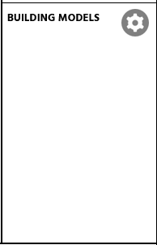

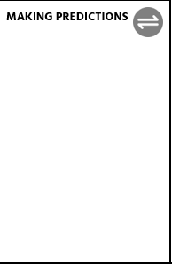

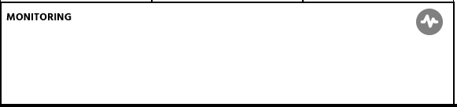
ML Canvas
- 3 models were employed: ResNet50, k-nearest neighbors, and the Gemini Pro Vision 1.0 Model.
- The model is updated whenever new products are released, whether by season or year.
Updating the model requires minimal time, but updating the features when the dataset is changed may take a day.
- Call to action: Implementing a feedback loop allows users to provide explicit feedback on the recommendations they receive.
- Parameters such as user ratings, likes, dislikes, and comments can be used to refine the recommendation algorithms
- ResNet50 can extract features from an image in less than a hundred milliseconds. Extracting features from all images takes approximately 30-45 minutes.
- Using KNN requires minimal to zero training time.
- The prediction time during inference is real-time.
The models are deployable leveraging Docker and GCP for deployment.
Test data will consist of images from other clothing datasets, such as the Clothing dataset on Kaggle.
Cosine similarity metrics are utilized to evaluate the model's performance.
- User Engagement Metrics: Track user interactions with the system, such as click-through rates, time spent on the platform, and user retention rates.
- Business Impact Metrics: Measure the impact of the ML system on KPI and objectives, such as sales revenue, conversion rates, and customer satisfaction scores
- Feedback Loop Metrics: Establish feedback mechanisms to collect input from end-users and stakeholders.

Slide 20
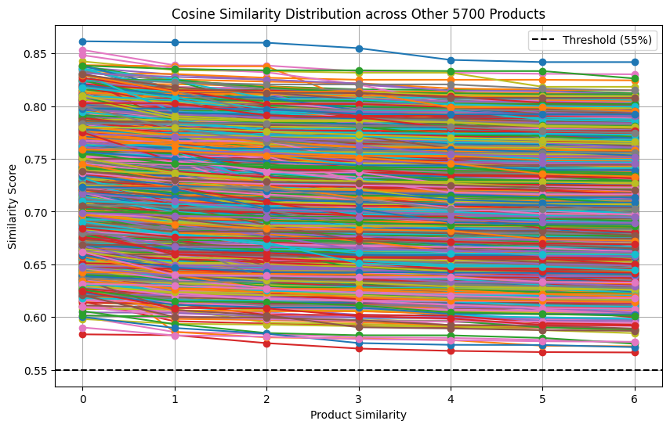
Model Evaluation
Dataset does not include labels or categories
Compute the cosine similarity between 7 embeddings of recommended items and the query item
User Feedback Integration

Slide 21
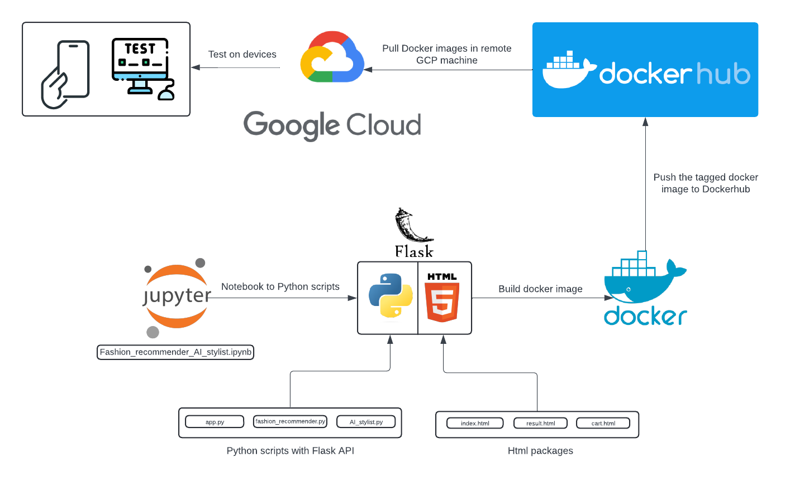
Model Deployment

Slide 22
Challenges & Issues encountered
Lack of Evaluation Method.
AI Stylist Decision.
Deployment Time Due to High Quality Dataset.

Slide 23
What's next?
Personalized Recommendation Systems
Developing Search Functionalities
Fashion Chatbot Integration
Optimizing the model to extract more complex features.

Slide 24

Demo
Fashion Recommendation System & AI Stylist:
http://34.70.91.51:5000/

Slide 25
Thank you for your attention

Slide 26

Any question?

